Slide 1
Tic-Tac-Toe using Artificial Intelligence (AI)
S6 CSE Gamma
Group 5
Karthik Variath, Shiyas Ahamed, Tushar Renji, Yadul Manoj
Guide: Mr. Biju Abraham

Slide 2
Problem Statement
To develop an application that implements the game Tic-Tac-Toe and to effectuate an optimal AI that consists of a learning system that is able to improve its performance with respect to a set of win states.
The project aims to achieve:
A functional UI that consists of the game-grid, menu options
An AI that is trained to win

Slide 3
Introduction
This project, at a visual level, is a web application that consists of the game Tic-Tac-Toe. The backend of the application consists of a pre trained AI algorithm called the Minimax algorithm, as well as a trainable AI.
The main menu of the application will consist of two options: use the pre-trained Minimax algorithm, or to train the AI to play the game.

Slide 4
Introduction
For the Minimax implementation, the UI will consist of the Tic-Tac-Toe grid and an option to reset the game once the game is over.
The initial working of the application begins with a starting move from the user. The AI then calculates and performs the best possible move it can make with the help of the algorithm implemented.
The user and the AI will take turns on interacting with the grid. The move done by the AI is instantaneous.

Slide 5
Introduction
The game will conclude only in a loss or draw outcome to the user. The AI will always try to maintain a draw/win state. It can never lose.
Apart from the Minimax algorithm, the application will also have a trainable AI implemented by an Artificial Neural Network that is developed using the libraries included in tensorflow and implemented through JavaScript.
The UI of the trainable AI will consist of the 3 x 3 grid, an option to reset the game, and the list of moves done by the user.

Slide 6
Introduction
The basic idea behind the learning system is that the system should be able to improve its performance with respect to a set of tasks by learning from training experience.
The tasks are defined by the games played. The performance corresponds to the percentage of games won, and the experience is an indirect feedback given via a solution trace generated from the games played against the user or itself.

Slide 7
Introduction
Initially the user plays a set of games with the untrained AI. After the conclusion of the game, the user gets the option to either train the AI to play as ‘X’ or to play as ‘O’ in the subsequent games.
The AI is able to do so as the set of moves that are played during each game is recorded as its training data. After training the AI with a significant number of games, it will be able to play games that will help it to reach a draw/win state.

Slide 8
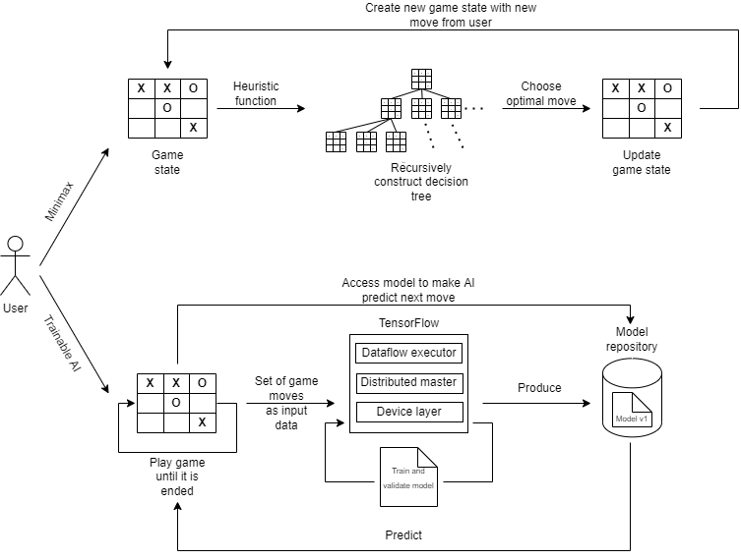
Architecture Diagram

Slide 9
System Overview - Minimax
The key to the Minimax algorithm is a back and forth interaction between the AI and the player, where the player desires to pick the move with the maximum score, and in turn, the scores for each of the available moves are determined by the AI deciding which of its available moves has the minimum score.
The scores for the opposing players moves are again determined by the turn-taking player trying to maximize its score and so on all the way down the tree to an end state.

Slide 10
System Overview - Minimax
A description of the minimax algorithm would be as follows:
If the game is over, return the score from X's perspective
Otherwise get a list of new game states for every possible move
Create a scores list
For each of these states add the minimax result of that state to the scores list
If it's X's turn, return the maximum score from the scores list
If it's O's turn, return the minimum score from the scores list

Slide 11
System Overview - Minimax
The utility value (score) of each game state (node of the tree) is calculated by the heuristic function - E = X’s possibility of winning - O’s possibility of winning
If E = 0 - The game is expected to end in a draw
If E = 1 - Corresponding player wins

Slide 12
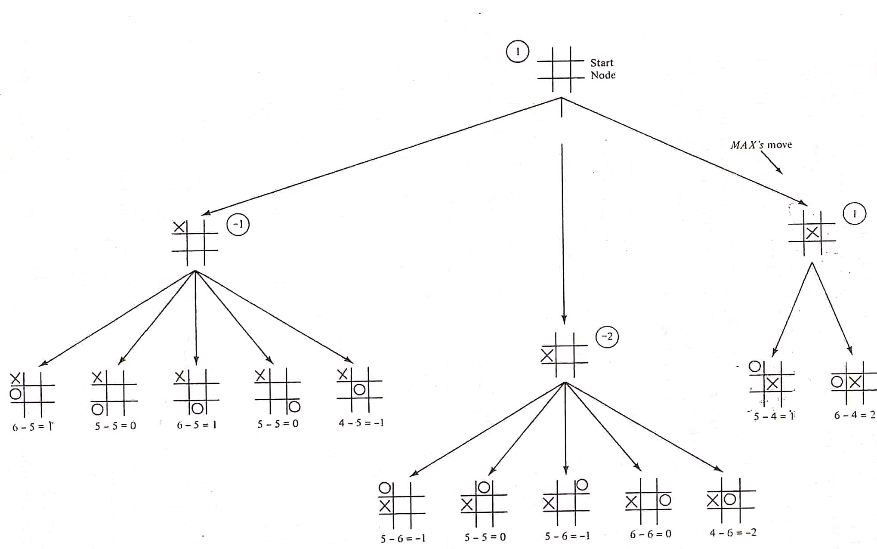
System Overview - Minimax

Slide 13
System Overview - Minimax
The UI for the Minimax algorithm is coded using the Javscript library p5.js
p5.js is a JavaScript library for creative coding. It is collection of pre-written code that simplify the process of creating interactive visuals with code in the web browser.

Slide 14
System Overview - Trainable AI
The trainable AI is developed using the libraries that are included in tensorflow and implemented through JavaScript.
The basic idea behind the learning system is that the system should be able to improve its performance (P) w.r.t to a set of tasks (T) by learning from training experience (E).
Task (T): Playing Tic-Tac-Toe
Performance (P): Percentage of Games won
Experience (E): Indirect feedback via solution trace (Game History) generated from games played against the user or itself

Slide 15
System Overview - Trainable AI
The final design is the AI model is split into four modules:
Experiment Generator: Its job is to generate new problem statements at the beginning of every training state. In our case, it just returns an empty initial board State.
Performance System: This module takes as input the problem provided by the Experiment Generator & then uses the improved Learning algorithm to produce a solution trace of the game at every epoch. In our case, this is done by simulating a Tic-Tac-Toe game between two players (cloned programs provided as training input).

Slide 16
System Overview - Trainable AI
3. Critic: This module takes the solution trace and outputs a set of training examples to be input to the Generalizer.
4. Generalizer: This module uses the training examples provided by the critic to update/improve the target function (predict the next move) by learning the desired weights.

Slide 17
System Overview - Trainable AI
The TensorFlow architecture consists of -
Device layer - The device layer contains the implementation to communicate to the various devices like GPU, CPU in the operating system where TensorFlow will run.
Distributed Master - Distributed Master has the ability to distribute workloads to different devices on the system.

Slide 18
System Overview - Trainable AI
Dataflow executor - TensorFlow uses dataflow graphs to represent computation in terms of the relationships between individual operations. In a dataflow graph, the nodes represent units of computation while the edges represent the data consumed or produced by a computation unit. The data flow executor computes the data flow graph optimally.

Slide 19
System Overview - Trainable AI
The AI is trained with the help of user inputs/data that are supplied in the form of winning games played.
If untrained, the AI will make a random move without any calculations or predictions.
Based on the moves defined by winning states, the AI makes an optimal move that is appropriate for the current state of the game.
With enough training the AI will be able to compete with the end user with 0% chance of loss.

Slide 20
System Overview - Trainable AI
The UI of the trainable AI is created with the JavaScript library ReactJS. It is a free and open-source front-end JavaScript library for building user interfaces based on UI components.

Slide 21
System requirements
CPU: Intel i3, 2nd Gen (Minimum)
GPU: Any integrated GPU for executing the AI training
Browser: Any browser that supports HTML5, JavaScript and CSS

Slide 22
Project Plan - Work breakdown
Sl no. | Step | Description
1 | UI design | Brainstorm and sketch designs for the main UI of the application, create mockups.
2 | Algorithm analysis | Generate algorithms and logic for the problems the application is supposed to solve (AI implementations).
3 | UI creation | Code the UI that is decided by the team.
4 | Code the algorithm | The entire logic of the AI functionality is coded.
5 | Test and deploy | The application is tested and deployed for use.

Slide 23
Project Plan - Work split-up
UI design - Shiyas & Tushar
Algorithm analysis - Karthik & Yadul
UI creation - Shiyas & Tushar
Algorithm coding -
Minimax: Shiyas & Yadul
Trainable AI: Karthik & Tushar
Testing - Done by all members

Slide 24
Project Plan - Schedule
Week 1 – [Complete]
Design of the UI by creation of mock-ups and sketches - Design of the tic tac toe grid, web page UI design, etc.
Algorithm analysis - Written algorithm of the program logic is created.
Week 2 – [Partially complete]
UI creation - Web page is created with the main menu, the grids, and with all the specific UI elements exclusive to the section.

Slide 25
Project Plan - Schedule
Algorithm coding - The program logic is coded. Minimax and the trainable AI is coded. All the underlying algorithms are made to interact with the UI.
Week 3 –
Testing - Done by all members

Slide 26
Implications
Application of machine learning concepts by teaching the AI to learn from previous actions and patterns to make better decisions and ultimately become flawless in execution.
Improving decision making time by recognizing common move patterns and auto-mapping (predicting) future actions.

Slide 27
Risks & Challenges
The design of the web application must be done in such a way that it will adjust to the different screen resolutions of devices.
The manual training data alone would not be sufficient enough to make a winning AI. A bigger data set may be required to train the AI.

Slide 28
Conclusion
In this project, we presented the training of an Artificial Neural Network (ANN) to play tic-tac-toe board game, by training the ANN to play the tic-tac-toe logic using the set of input win states provided by the user.
It is also implemented with the pretrained AI algorithm called the Minimax algorithm that works on the basis of mathematical calculations that predicts the optimal move to be made.

Slide 29
References
https://tensorflow.org
https://towardsdatascience.com/tic-tac-toe-learner-ai-208813b5261
Dalffa, M., Bassem, S. Abu-Nasser, Samy, S. Naser, A. (2019). Tic-Tac-Toe Learning Using Artificial Neural Networks. Department of Information Technology, Faculty of Engineering and Information Technology, Al-Azhar University - Gaza, Palestine.
Felstiner, C. (2019). Alpha-Beta Pruning. Whitman.edu.
Swaminathan, B., Vaishali, R. and Subashri, T. (2020). Analysis of Minimax Algorithm Using Tic-Tac-Toe. Rajalakshmi Engineering College, Chennai.

